Slide 1
Architecture management in MATLAB
Testing and validation plaforms
Master Degree in Smart Energy Systems

Slide 2
Contents
Properties of requirements
Language of requirements

Slide 3
Contents
This tutorial follow example:
https://www.mathworks.com/help/systemcomposer/ug/mobile-robot-workflow.html

Slide 4
Creating architectures
1

Slide 5
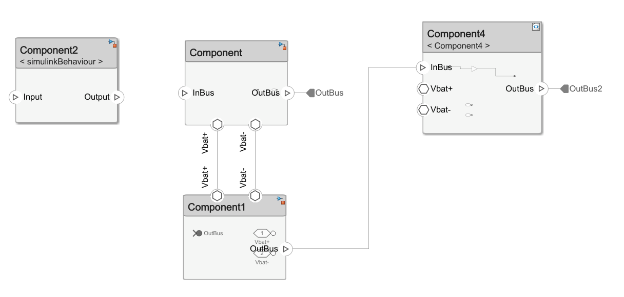
Fundamental components
The fundamental block of an architecture is the component.
Ports
Signals
Component
Physical ports (for Simscape)

Slide 6
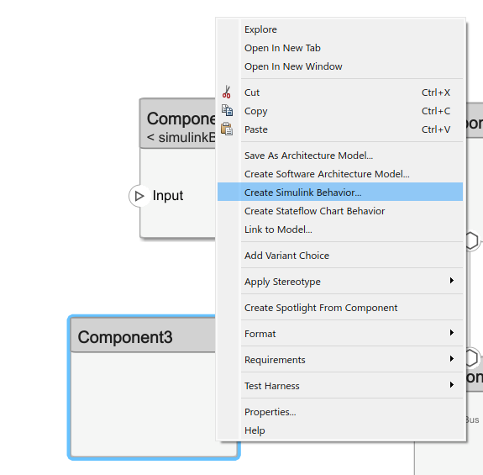
Fundamental components
A component can be linked to other files:
Architecture model: nested architectures.
Software Architecture Model: nested software architecture model.
Simulink Behavior: Classic Simulink file.
Stateflow Chart Behaviour: behavior in stateflow.
Link to model: link to an existing model

Slide 7
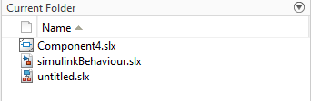
Fundamental components
A component can be linked to a behaviour (simulation/stateflow chart).
Subsystem component: behaviour embedded in System Composer.
Referenced subsystem: behaviour in separate subsystem file.
Referenced component: behaviour in separate Simulink file.
Can’t be used with physical ports.
Architecture file

Slide 8


Fundamental components
A component can be linked to a behaviour (simulation/stateflow chart).
Subsystem component: behaviour embedded in System Composer.
Referenced subsystem: behaviour in separate subsystem file.
Referenced component: behaviour in separate Simulink file. Can’t be used with physical ports.
Architecture and behaviour only in one file
Subsystem in separate file. Can be reused.
Whole model in separate file. Can be tested separately.
Subsystems can’t be tested separately
Subsystem file can’t be simulated outside architecture
Can’t use physical interfaces

Slide 9
Stereotypes
2

Slide 10
Stereotypes
When an architecture is defined in System Composer, you may need to add additional information to components.
You can see here a hardware architecture example.
We may need to classify components or signals to make the architecture more readable.

Slide 11
Stereotypes
Stereotypes help managing additional information.
Component/signal types can be customized with stereotypes.
Without stereotypes
With stereotypes

Slide 12
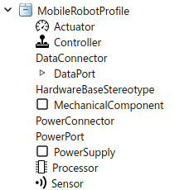
Stereotypes
The steps to work with stereotypes are:
Create a profile: a group of stereotype definitions. We choose which kind of signals and components we heave. We define their properties and styles.
Import a profile: We can use the same profile in different architectures, so we need to import one to ours.
Assign stereotypes: Assign a stereotype to each component/signal.

Slide 13
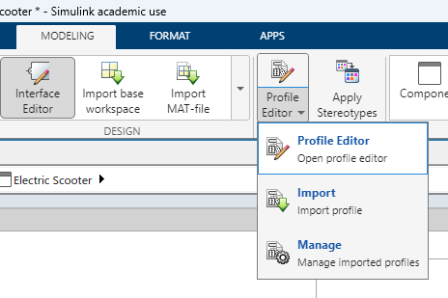
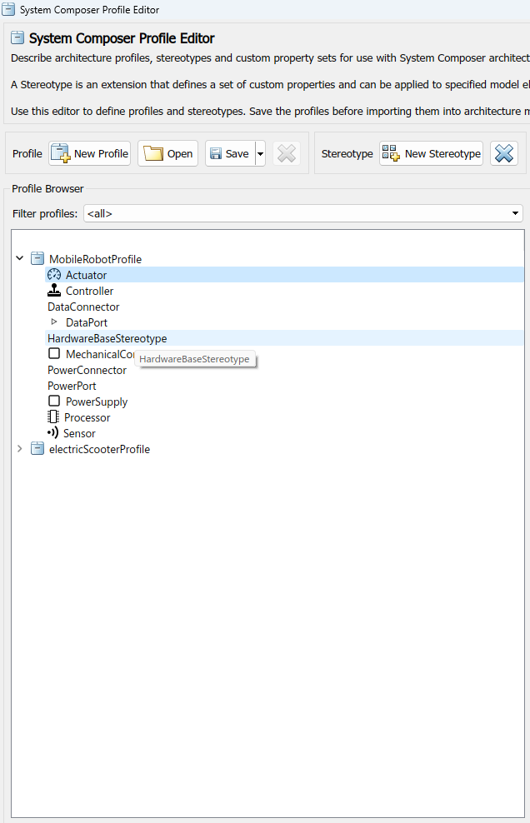
Stereotypes
Stereotype profiles are created and managed with the profile editor.
A profile is saved separately in a .xml file.
Inside a profile we can have several stereotypes.
This example is a hardware architecture, so defines different hardware components: actuators, controllers, processors, sensors,… As well as connectors: power, data,…

Slide 14
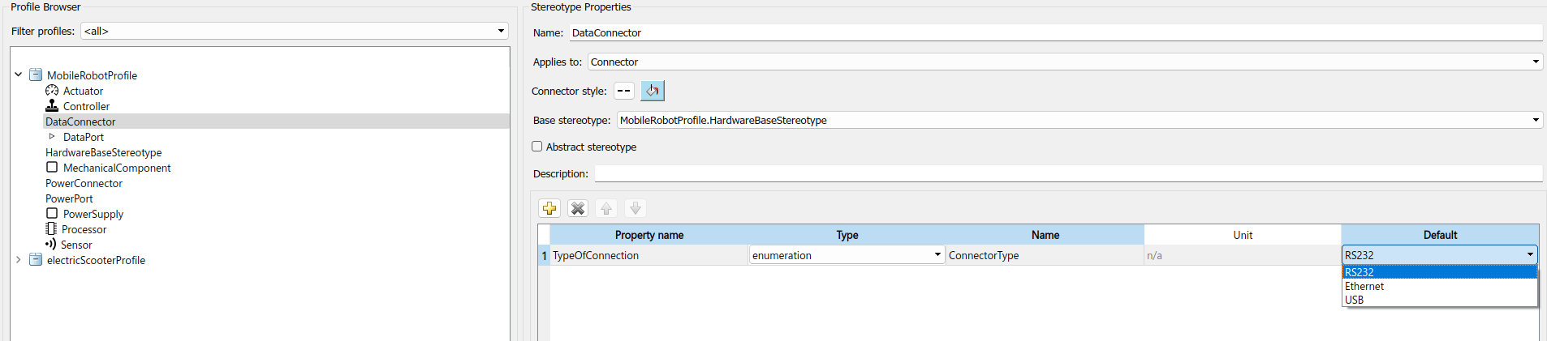
Stereotypes – create profile
The information linked to a stereotype is specified using properties.
For example, the DataConnector stereotype has a field to specify the connector type.

Slide 15
Stereotypes – create profile
The information linked to a stereotype is specified using properties.
For example, the DataConnector stereotype has a field to specify the connector type.

Slide 16
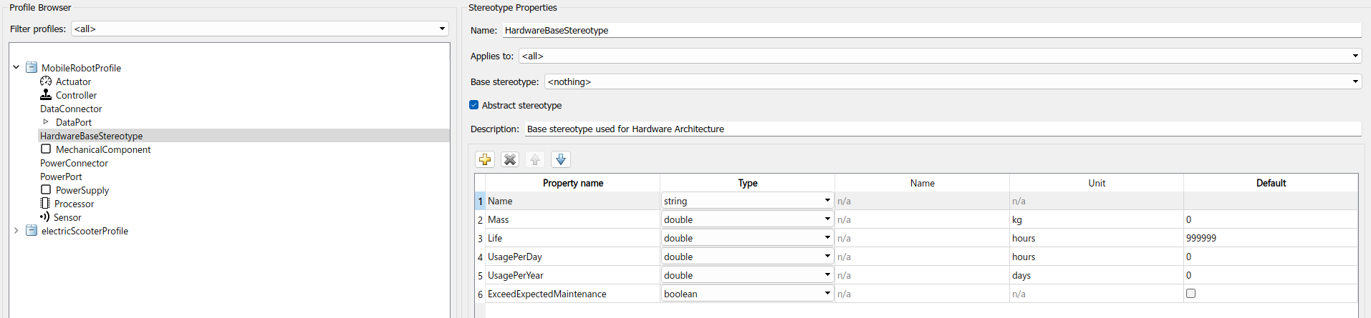
Stereotypes – create profile
A Base stereotype can also be used.
Instead of defining properties in all stereotypes one by one, we can create a base that all will share.
DataConnector has its properties + all the ones defined in the base stereotype

Slide 17
Stereotypes – import profile
After creating a profile, it must be imported to the architecture.
When a profile is created, it is saved as a .xml file. That file must be imported using the import button.
Once imported, stereotypes will be available.

Slide 18
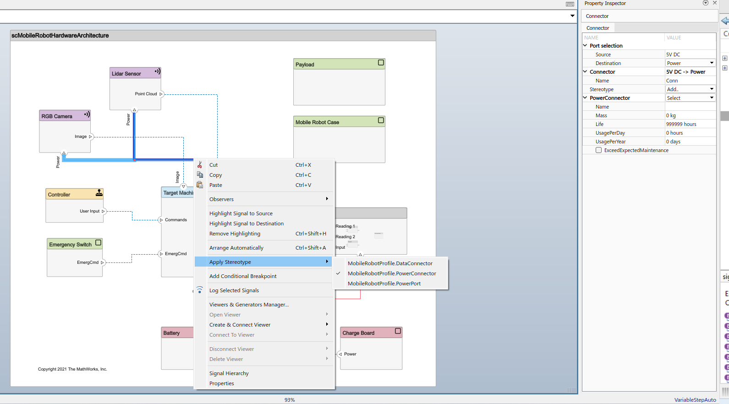
Stereotypes – assign stereotypes
Stereotypes are assigned right-clicking the component/signal.
The properties linked to the stereotype are shown in the property inspector.

Slide 19
Stereotypes – assign stereotypes
The final result is an architecture with stereotypes defined.

Slide 20
Link to requirements
2

Slide 21
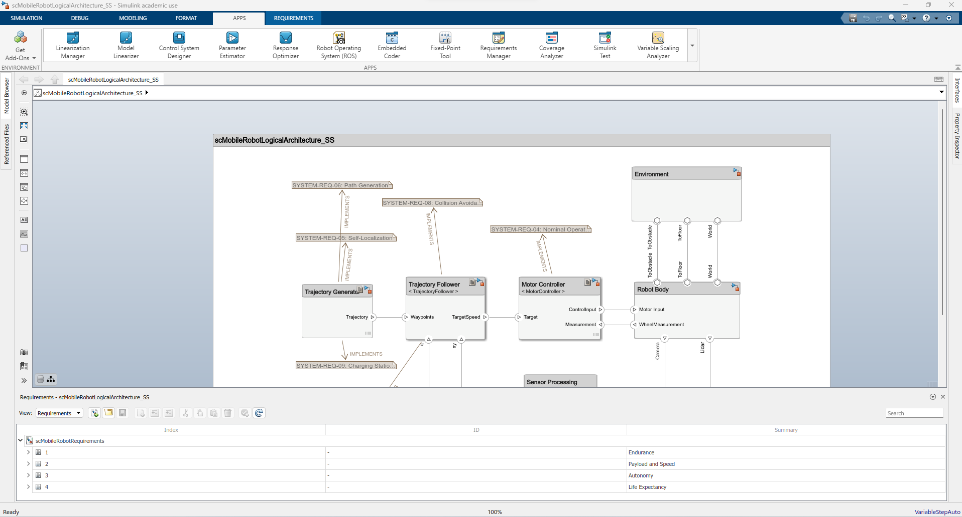
Requirements in system composer
Once we have our architecture defined, we can link each component to requirements (drag and drop).
Requirements are available in Simulink.

Slide 22
Requirements in system composer
Previously created requirements can be loaded to Simulink.
Requirements can directly be created in Simulink also.

Slide 23
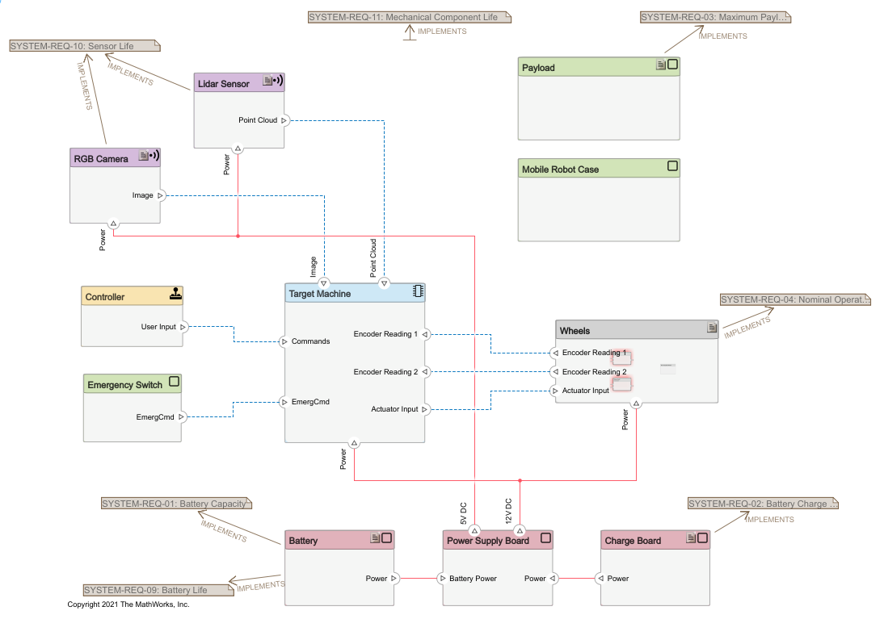
Requirements in system composer
Requirements can be linked to a particular component or the whole architecture.

Slide 24
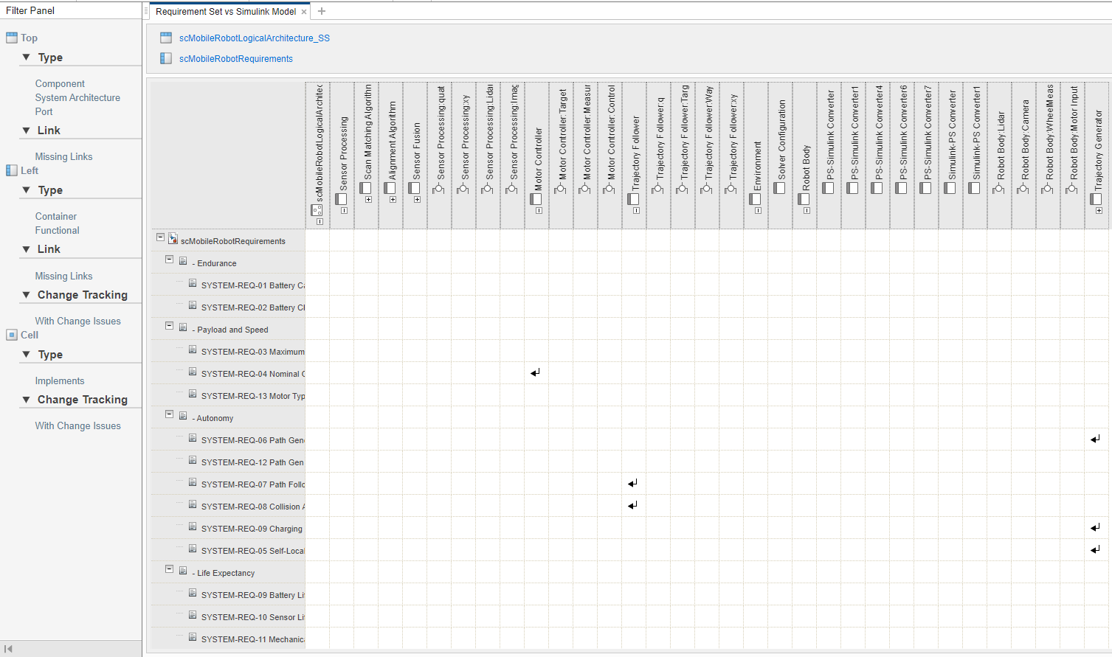
Requirements in system composer
The traceability matrix shows the link to different artifacts (other requirements, architectures,…).
architecture
requirements

Slide 28
References
3

Slide 29
References
Holt, J., Perry, S. A., & Brownsword, M. (2012). Model Based Requirements Engineering (Institution of Engineering and Technology, Ed.).
Hull, E., Jackson, K., & Dick, J. (2011). Requirements Engineering. Springer London. https://doi.org/10.1007/978-1-84996-405-0
IEEE Standards Association. (2021). 2021 IEEE SA Standards Style Manual. https://mentor.ieee.org/myproject/Public/mytools/draft/styleman.pdf

Slide 30
Eskerrik asko
Muchas gracias
Thank you
Jon del Olmo Larrañaga
jdelolmo@mondragon.edu
Iosu Aizpuru
iaizpuru@mondragon.edu
Orona Ideo - Fundazioa eraikuntza
Jauregi Bailara, z.g.
20120 Hernani (Gipuzkoa)
Tel. : +(34) 943 739765
www.mondragon.edu

